Slide 1
Flexible Instruction Processors
Wayne Luk & Peter Y.K. Cheung
Imperial College
CASES 2000
ACME LAB
Notes:
International Conference on Compilers, Architecture, and Synthesis for Embedded Systems, 2000.

Slide 2
“Not So General” Purpose Processors
GPPs lose performance when dealing with non-standard operations and data
Particularly apparent in embedded systems
  Cell phones
  Medical appliances
  Digital cameras
  PDAs

Slide 3
Two roads to customization
Augment GPPs with programmable logic
  Couple standard processor (ARM, MIPS) with an FPGA fabric
  Fixed processor instruction set
  FPGA implements custom instructions
Implement them in FPGAs
  Customize instructions at compile time or at run time

Slide 4
Flexible Instruction Processors
FIPs are assembled by parameterized processor templates
Allows customized hardware to be exposed as new instructions
Critical resources can be adjusted according to domain requirements
Can implement same instruction set with different design tradeoffs
Notes:
The processor and its associated op-codes provide a means to optimize control paths through optimizing compilers. Conventional ad-hoc sharing regimes are harder to optimize.
Resource management can even be done at run-time through the use of run-time reconfiguration.
Can enable high-level data structures to be easily supported in hardware.

Slide 5
FIPs Template
Templates are modules connected together by communicating channels
Can instantiate different styles of processors
  Stack, register, etc.
Customizations
  Removal of resources
  Changing data widths
  Vary degree of pipelining
Implemented in Handel-C
Fetch
send instruction
receive done
receive
instruction
decode()
switch()
{
case:
…
}
send done
Instr 1
Execute

Slide 6
Enhancing Processor Templates
Can group modules differently to achieve different processor styles
Superscalar
  More than one execution module
Hybrid
  Different execution modules (stack/register)
Fetch
I1
Execute
Execute
I2
…

Slide 7
Compilation Strategy
Optimizes known target code to known target FIP
Reorganizes code to take advantage of ILP
Similar to Java’s Just-In-Time compilation
Source Code
Compile with standard compiler
Annotate with possible optimizations
Compiled
Code
Annotated
Source Code
Optimize compiled code for target FIP
Compile with generated compiler
Hardware Description

Slide 8
Compilation Strategy
Annotate source code with profile information
  Frequency of instruction use
  Common instruction groups
  Shared resources
Use annotations to drive optimization of code and FIP
Compile with a FIP-specific compiler
Source Code
Compile with standard compiler
Annotate with possible optimizations
Compiled
Code
Annotated
Source Code
Optimize compiled code for target FIP
Compile with generated compiler
Hardware Description

Slide 9
FIP Optimizations
Custom instructions
  Direct hardware implementations can be exposed by custom instructions
  Reduces number of fetch-decode instructions
  Increases area
Processor-specific
  Can replicate much-used resources
  JVM: allow concurrent reads of top of stack
  JVM: allow reads of top ‘n’ elements

Slide 10
Implementation: JVM
Implemented FIP-based Java Virtual Machine
  #1: segregated resources that are shared
    Good area utilization and the expense of routing congestion
  #2: two-stage pipeline & only shares stack and main memory
  #3: deeper pipelines for certain instructions and ‘register’ style improvements
    Top-of-stack registers are replicated – writes are done back to stack directly, replicated registers updated during the fetch cycle
    Most instructions have 4 stages, some 5-6 stages
    Routing is pipelined

Slide 11
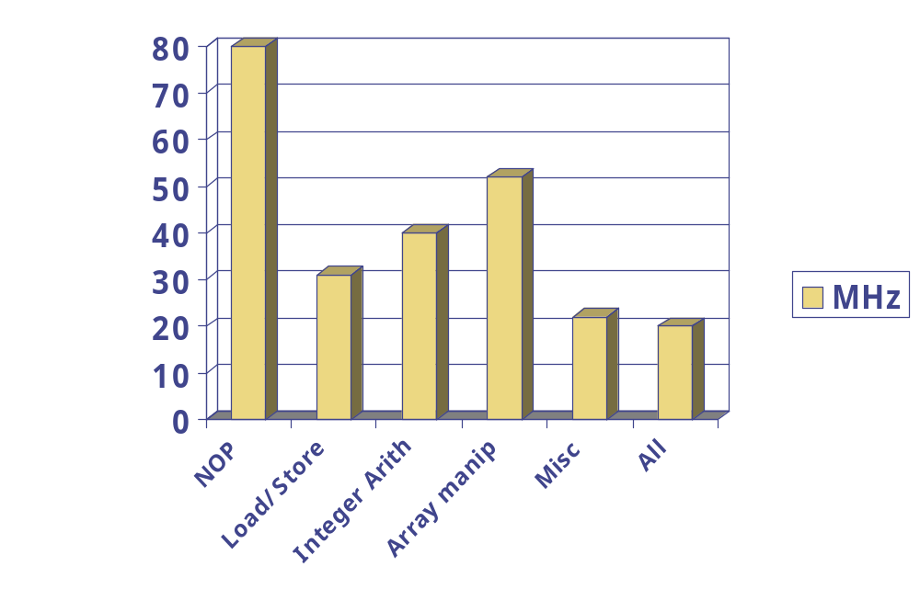
Results

Slide 12
Results
Devices CaffineMark Speedup
Software JVM 502 1
FIP JVM 1019 2x
Pipelined FIP JVM 3665 7x
GMJ30501SB 13332 27x
FIP implemented in Xilinx Virtex @33MHz
GMJ30501SB == 200MHz ASIC

Slide 13
Impact of custom instructions
Link list insertion (100 links)
  Direct hardware: 2.3ms
  FIP-JVM: 6.4ms, 22 instructions
  ASIC: 1ms
Adding ‘insert link’ instruction
  12 cycles to complete
  Saves 10 cycles and 10 fetch/decodes

Slide 14
Implementation: AES
Device Cycles/Block Slices/BRAM Mbps/MHz
Software 340 N/A 0.4
FIP (I) 99 1770/2 1.3
FIP (II) 32 1393/10 4
Hardware I 11 460/10 11.5
Hardware II 1 2679/82 129.6
FIP (I) direct implementation of transforms
FIP (II) table-lookups for transforms
Hardware I Spartan II 100-6
Hardware II Virtex-E 812-8
Notes:
Software: C/C++ on PIII-933MHz, 350Mbps
FIP I: 51.7Mbps
FIP II: 160Mbps
Hardware I: 0.52Gbps (45MHz)
Hardware II: 7Gbps (54MHz)

Slide 15
Optimizations
Opcode chaining
  Store intermediate results in temporary registers
  Removes push/pop and alleviates sequential nature of stack-based machines
Galois Multiplication is single instruction
  No procedure call overhead
  8.5 cycles instead of 30
Introduce predicate registers to allow instructions to execute in parallel
  6 cycles instead of 30

